Slide 1
CSE 431
NATURAL LANGUAGE PROCESSING
Paper Presentation Individual
SentiGOLD: A Large Bangla Gold Standard Multi-Domain
Sentiment Analysis Dataset and its Evaluation
Presented by: Sayma Akter Lubna
ID : 20301450
Sec: 01

Slide 2
INTRODUCTION
Task of classifying text in the sentiment domain
Important as it finds subjective information from text & for evaluation of LLMs
Most existing sentiment analysis datasets are limited to a few languages and certain domains
"SentiGOLD: A Multi-Domain Sentiment Analysis Dataset for Bangla" presents a new dataset for Bangla sentiment analysis
The dataset includes 70,000 samples from different domains and sources
The dataset can be used for different sentiment analysis tasks, such as product reviews, social media analysis, and customer feedback
The paper underscores efforts to ensure dataset quality through a gender-balanced linguist team and rigorous maintenance of domain and class distribution.

Slide 3
Objective/Motivation
The paper's motivation is to fill the gap in Bangla sentiment analysis datasets by addressing issues with size, diversity, and annotation quality. The authors emphasize the need for a standardized dataset, lacking in Bangla sentiment analysis, crucial for accurate models. The authors listed several domains of interest, including politics, sports, business, places, education, technology, health, religion, and entertainment, from the socioeconomic perspective of Bangladesh.
SentiGOLD, a large, diverse dataset collaboratively established with national stakeholders, aiming to set a benchmark for sentiment analysis in Bangla and support future research and development in the field.

Slide 4
Background/Paperwork
The author of SentiGOLD refers to multiple English and high resources language paper, explaining the low resourceness of SA in Bangla and thus imposing on it’s importance. In Bangla, the sentiment classification has little to no resource.
- Washington Cunha et al. (2021) on the cost-effectiveness of neural and non-neural approaches and representations for text classification.
- Jianfeng Deng et al. (2021) on an attention-based BiLSTM fused CNN with gating mechanism model for Chinese long text classification.
- Jacob Devlin et al. (2018) on hierarchical attention networks for document classification.
- Jerrold H Zar (1999) on biostatistical analysis.
- Lei Zhang et al. (2018) on deep learning for sentiment analysis: a survey.

Slide 5
Used Data & Methodologies

Slide 6
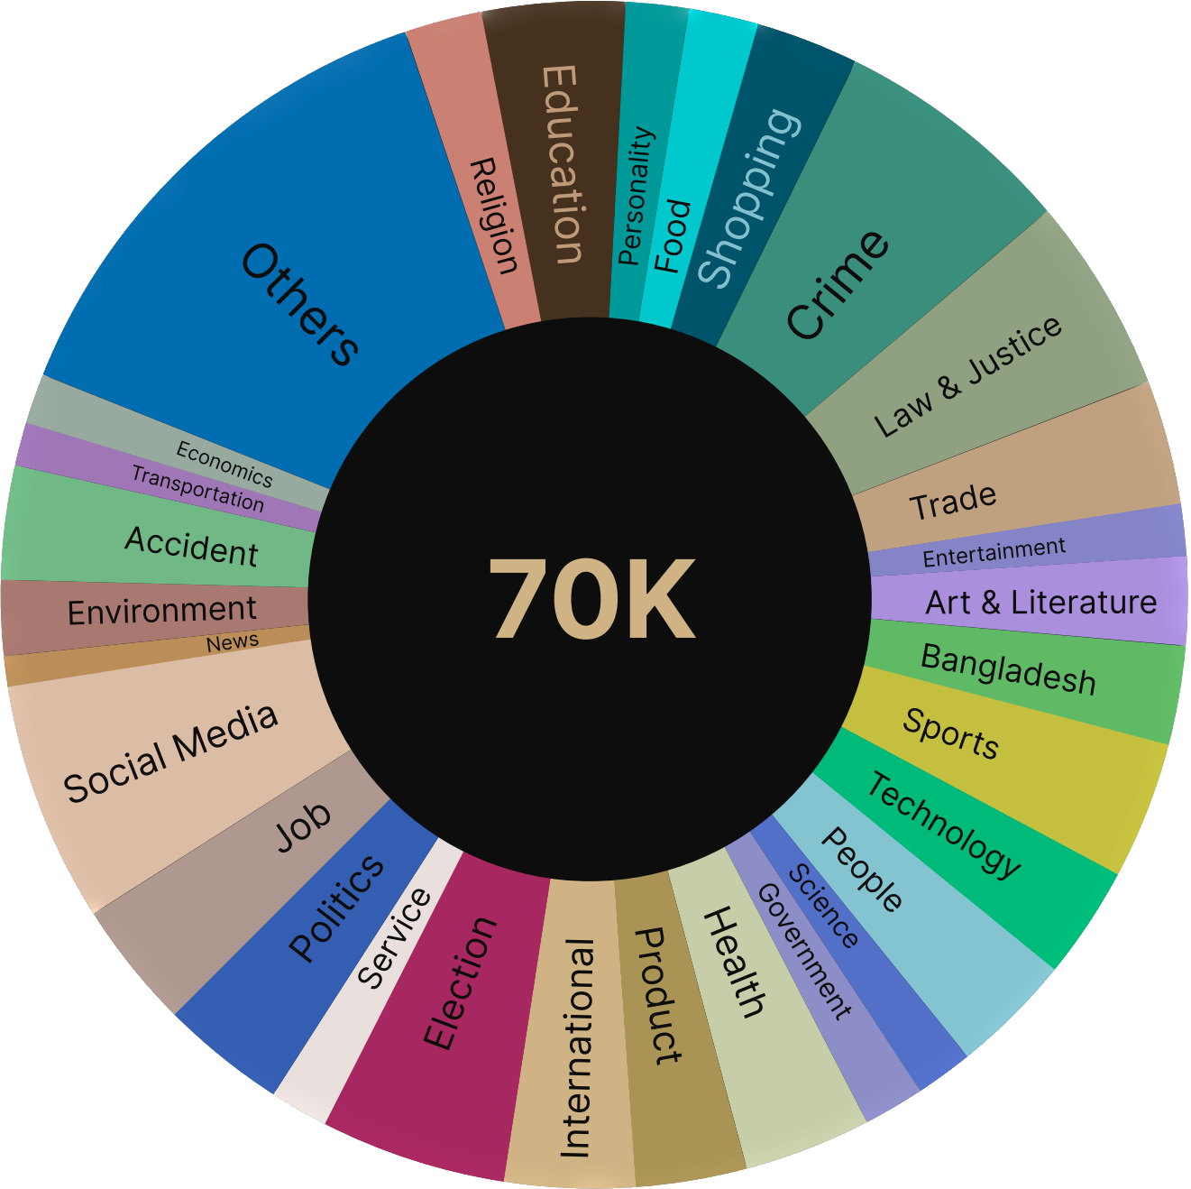
Multi Domain
Almost 30 Domains are covered in SentiGOLD
Creation of SentiGOLD, a multi-class classification dataset for Bangla text.
Annotation by three human annotators and validation by one human validator.

Slide 7
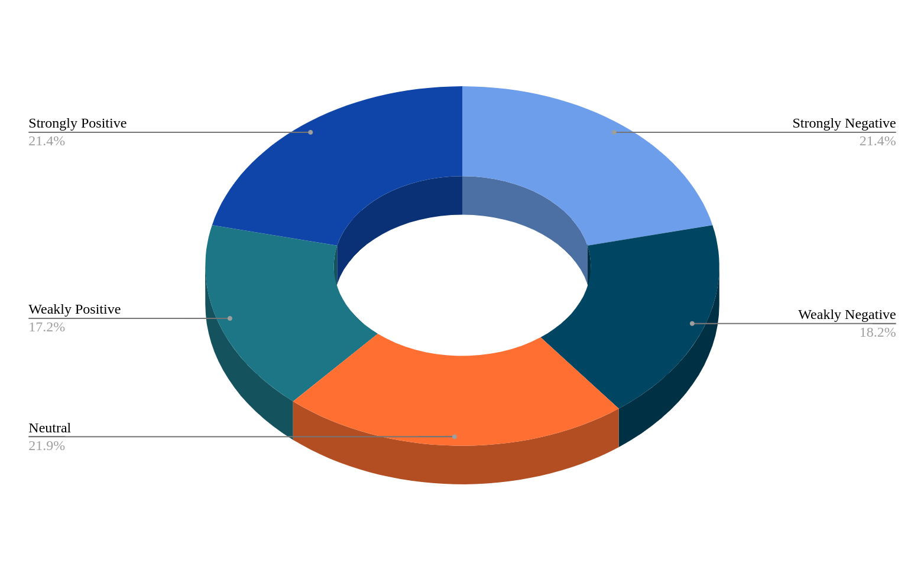
Multi Class
5 Spectrum of Sentiment, balanced
1 Strongly Negative 21.1%
2 Weakly Negative 18%
3 Neutral 21.6%
4 Weakly Positive 17%
5 Strongly Positive 21.1%
Gathering unprocessed text data from various sources (newspaper websites, Bangla blogs, YouTube comment sections, Facebook posts and comments, technical blogs, Bangla wiki, etc.).
Identifying topic-related domains, including politics, sports, business, education, technology, health, religion, and entertainment.

Slide 8
Data Collection/Cleaning & processing
Collected data from different sources, and crawled contents taking under some consideration to maintain its consistency.
Cleaning raw data by removing unnecessary noise (HTML tags, URLs, romanized Bangla text, repeating punctuations, repeating white spaces, other language words, non-Unicode Bangla text, except emoticons).
Application of Unicode normalization and elimination of unnecessary white space.
Identification of text language using TextBLOB and filtering out non-Bangla data.
After collecting a sufficient amount of raw data from various sources, the authors began the data cleaning and processing steps.

Slide 9
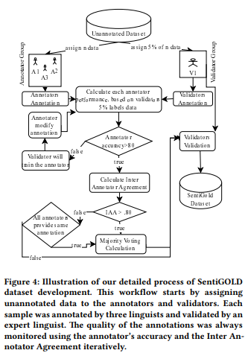
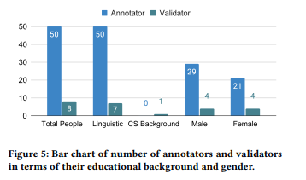
Annotation
A team of 50 annotator and 8 validators annotated this dataset.
An annotation guideline was developed for both the annotator and the validators to ensure consistency of data annotation.
Open source annotation system Annotation Management System(AMS) was used.

Slide 10
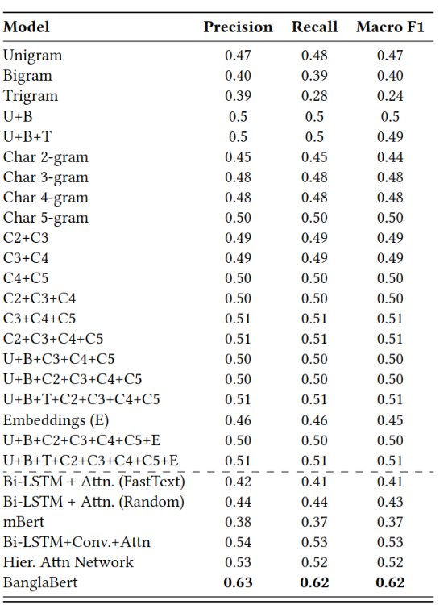
Methodology
Initial Approach was to use feature models: unigram, bigram, trigram, and different combinations.
moved to different combinations of BiLSTM, Hierarchical Attention Network(HAN), biLSTM CNN with Attention(BCA) models.
Lastly, moved to BERT-based pretrained language models. A pretrained language models such as mBert and BanglaBert.

Slide 11
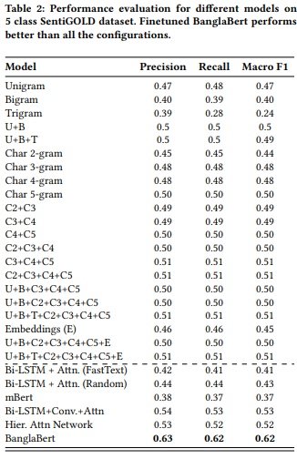
Results & Discussion
Best result of 0.62 macro-f1 for 5 classes. BanglaBert is a language model trained on the raw Bangla text, which is why it worked very well while we fine-tuned it with SentiGOLD
Competitive results from BCA and HAN. It is also worth mentioning that different mixing of hand-crafted feature-based algorithms performs well because of different algorithms

Slide 12
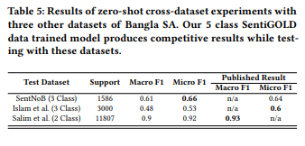
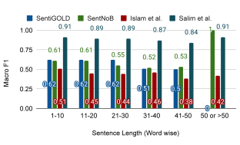
Results & Discussion
Competitive test data.
In case of SentNoB, model outperformed their published result.
Islam et al. and Salim et al., model produces competitive results, which indicates that proposed SentiGOLD dataset is much more diverse and generalized than the recently published dataset.
tested on three different datasets with variable sentence lengths, and it consistently performed well across all datasets.

Slide 13
Limitations
First Limitation
Limited Generalization to Informal Texts: The fine-tuned model, BanglaBert, faces challenges in making correct predictions when exposed to data samples containing humorous/sarcastic words, politically controversial terms, provincial vitriols, and indirect attacking words. This limitation arises from the model's primary training on formal texts, indicating a potential lack of generalization to noisy or informal language.
Second Limitation
Incomplete Training Dataset:
The SentiGold training dataset used for fine-tuning may not cover all possible witty or harsh words, suggesting a limitation in the diversity of training data. This gap in the dataset could result in the model's inability to accurately predict sentiments for certain types of language.

Slide 14
Conclusion
Bangla Sentiment Classification at the current state is far from perfection
The paper discusses the introduction of the SentiGOLD dataset to enhance linguistic resources for Bangla sentiment analysis. The dataset is highlighted as approximately 4.5 times larger than previous Bangla sentiment analysis resources and spans 30 domains, more than twice the coverage of earlier datasets. The development process incorporates a novel annotation procedure aimed at improving annotation quality, with potential applicability to other South Asian languages. The authors express their commitment to ongoing work, exploring different modeling architectures and incorporating diverse data from additional domains to enhance solutions. The contribution of SentiGOLD is positioned as a competitive benchmark, encouraging further research and improvements within the community.

Slide 15
THANK YOU

